Slide 1
NYC-311
Quality of Life Complaints in NYC
John Procyk
Lianze Ma
Mengyi Gong
Pallavi Rastogi

Slide 2
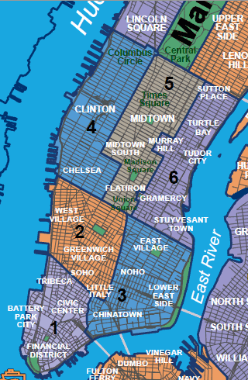
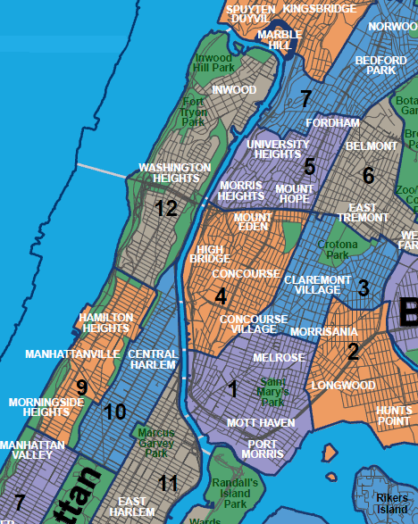
Neighborhoods of New York – Manhattan and Bronx

Slide 3


Quality of Life Issues
Communities have distinct problems and they want solutions.

Slide 4
What Are We Looking For?
What are the Quality-of-Life issues affecting different parts of the city:
Low Income Vs High Income Areas
Urban Vs Suburban
Seasonal problems:
Summer Vs Winter
Weather:
A quick look at the issues around Hurricane Sandy

Slide 5
Data Sources
Nycopendata.org
Socrata repository “Everything New York”
Zipskinny.com
Demographic Data by Zip Code
Health.ny.gov/statistics
Zip codes grouped into neighborhoods.

Slide 6
ASP Platform
Microsoft Active Server Pages
Server-based technology
Get it to the customer NOW!
MySQL Database
Free, Open Source, full-featured Relational Database
Tableau
Interactive Dashboard– easy to use, easily configurable
Python
Data extraction, scrubbing, transfer

Slide 7
Google App Engine Platform
Google App Engine
Server-based technology
HTML and Java Script
Google Cloud SQL
Tableau
Interactive Dashboard – easy to use, easily configurable
Python
Data extraction, scrubbing, transfer

Slide 8
Demonstration

Slide 9
Guide Map
Users could easily get two areas to compare according to the location, income etc
A guide to view the whole New York and can select the following details:
Zip Code
Neighborhood
Average Income
Below Poverty Line

Slide 10
Guide Map
Observations
Hunts Point + Longwood has the lowest average income, while the lower Manhattan has the highest income.
Average income of the south part of NYC is quite the same, while the north part of NYC has a gap between rich and poor

Slide 11
Observations
After the initial period of search and discovery:
Target areas of concern:
Low-income areas had high levels of “Housing/Landlord” issues (problems typical of inner-city low-income housing)
See “Bronx Park vs Inwood” for Jan 2013
Removing these issues uncovers other issues.
Interesting observation:
Parking, muni-meter problems don’t appear until income reaches approx. $20,000. (East Harlem and Morrisania)
This is a huge problem, along with Taxi problems, in high-income areas. (Upper East Side and Gramercy/Murray Hill)

Slide 12
Observations (continued)
Correcting for Housing issues, low-income areas complain less than high-income areas.
See Morrisania vs Gramercy Park for Aug, 2012
Suburban issues include trees, sewers, garbage collection, street lights.
See South Shore vs Port Richmond for Aug, 2012

Slide 13
Month-wise Analysis
We analyzed the month of October 2012 and November 2012 with Tableau Public.
We focused on the overall number of complaints during this month.

Slide 14
Month-wise Analysis(Continued)
We observed that during Hurricane Sandy period ( Oct 22 - Oct 31), the number of complaints of damaged trees was enormously high (as expected).
The maximum number of damaged tree complaints were from Staten Island where major destruction took place.
Such kind of visualization could help the concerned authorities to get more prepared for such complaints in the future.

Slide 15
Month-wise Analysis(Continued)
Heating issues are major concern in Manhattan and Bronx. In Staten Island, heating is not a major issue, as most residences are owner-occupied houses.
Noise is also a major problem in Manhattan in comparison with other neighborhoods.

Slide 16
Month-wise Analysis(Continued)
When we compared October to January complaints, we observed that heating was the major concern in all boroughs during these winter months.
The water system is not a major problem in Bronx and Manhattan but was a concern in Staten island during January 2013.

Slide 17
Further Work
Include longer time duration, for example 5 years or 10 years
Fetch data dynamically from nycopendata and insert directly in to Google Cloud SQL
Include other boroughs (Queens, Brooklyn).
Add GUI elements for better browsing experience (tree control for Borough/Hood), scroll-bar to see the next 10 complaints.
Add additional relevant demographic data.

Slide 18
Limitations
Features available in Tableau Public are limited
Connection to My SQL, Oracle are available in the enterprise version
Tableau does not accept/update inputs from main web page

Slide 19
Conclusions
This application is an easily-accessible source of information and questions for a social scientist.
What are the quality-of-life issues by income level?
Why are there relatively fewer complaints in low-income areas than in privileged areas?
Is the current level of availability to transportation a hindrance to upward mobility?

Slide 20
Conclusions
Is 311 being used properly?
What are the response rates to 311 complaints?
Are quality-of-life issues being resolved?

